Slide 1
27. ELASTIC BEANSTALK
With Elastic Beanstalk, you can quickly deploy and manage applications in the AWS cloud without worrying about the infrastructure that runs those applications. AWS Elastic Beanstalk reduces management complexity without restricting choice or control. You simply upload your application, and Elastic Beanstalk automatically handles the details of capacity provisioning, load balancing, scaling, and application health monitoring.
You can also perform most deployment tasks, such as changing the size of your fleet of Amazon EC2 instances or monitoring your application, directly from the Elastic Beanstalk web interface.
From the Console Home page, choose Elastic Beanstalk under Compute section.
Then choose Create New Application to create a new one.

Slide 2
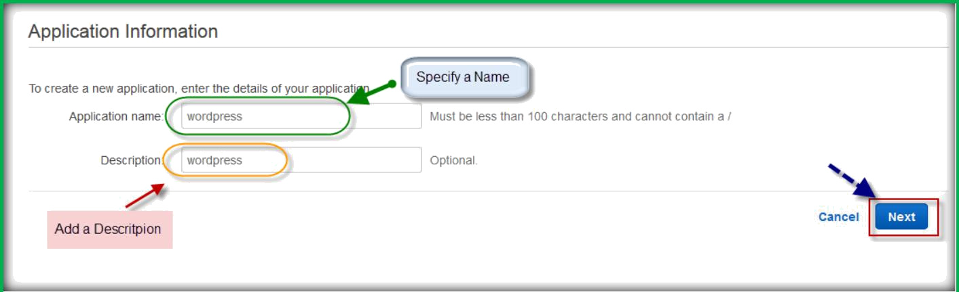
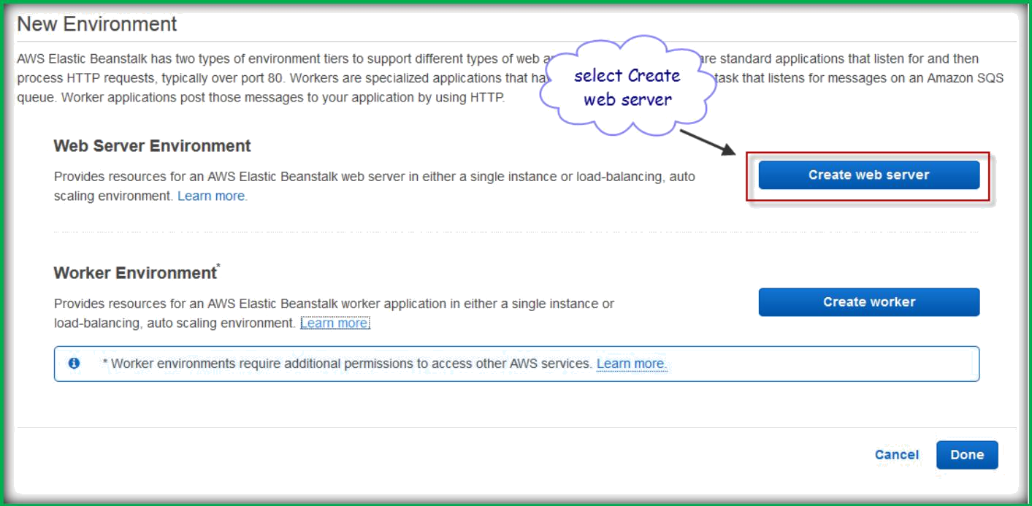
Specify a name and add description for your application, then choose Next.
From the new Environment page, choose Create web server.

Slide 3
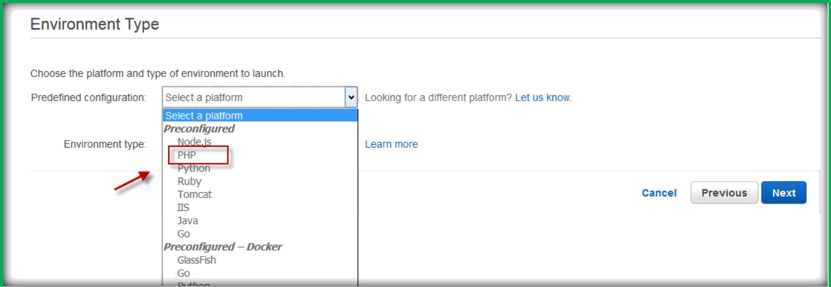
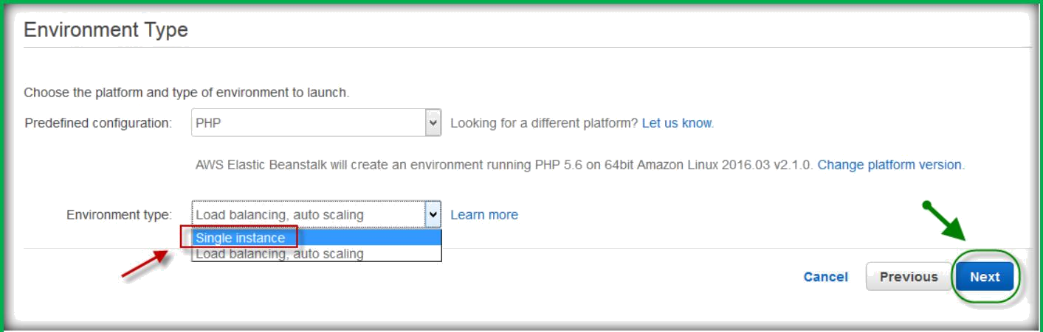
Choose Environment type from the predefined configuration drop down list, I have selected PHP here.
Then choose either single instance or Load balancing, auto scaling from environment type drop down list then click on next.
From application version page, choose Upload your own and upload an application.

Slide 4
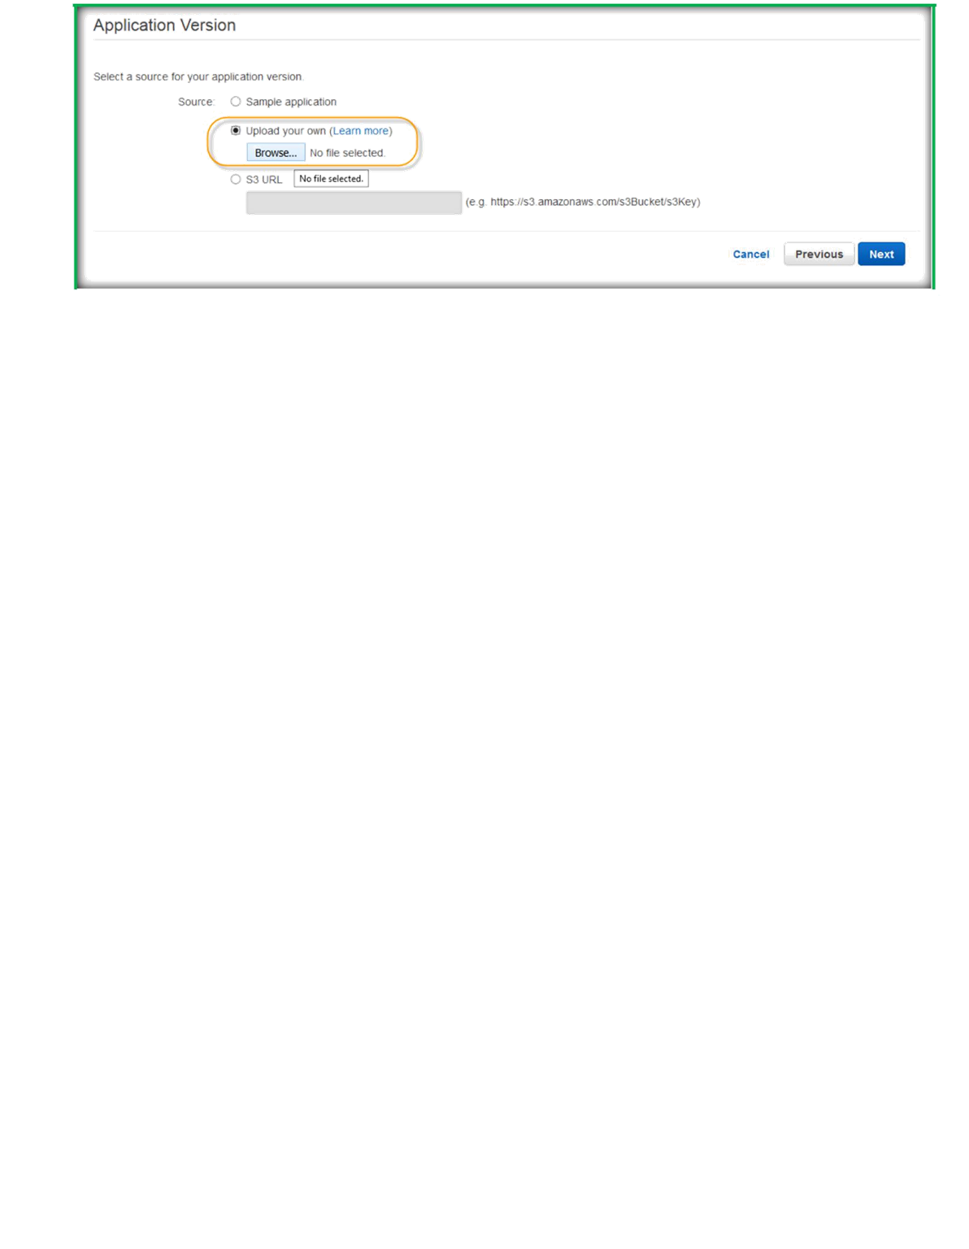
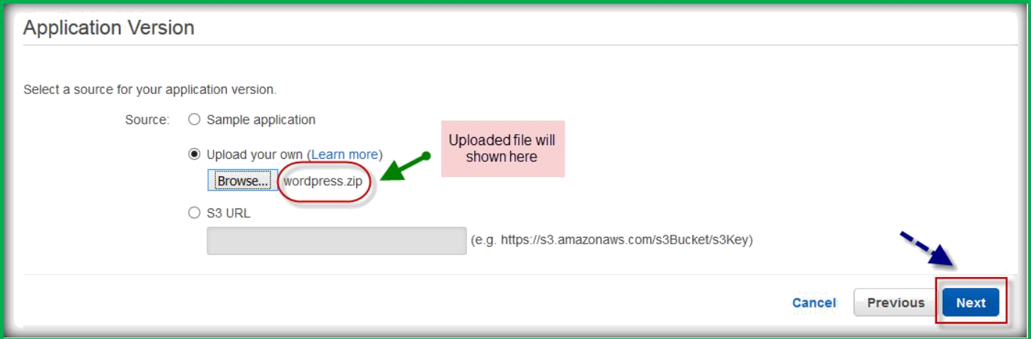
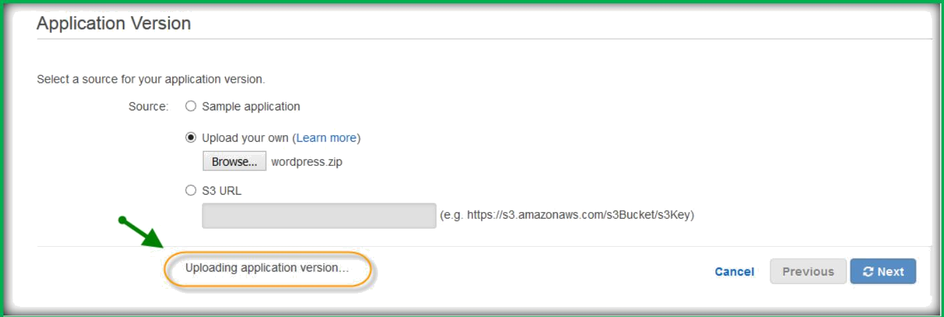
Once uploaded, choose Next.
You can see the status of application uploading.
Specify environment name, and check availability of environment URL, add description, then choose Next.

Slide 5
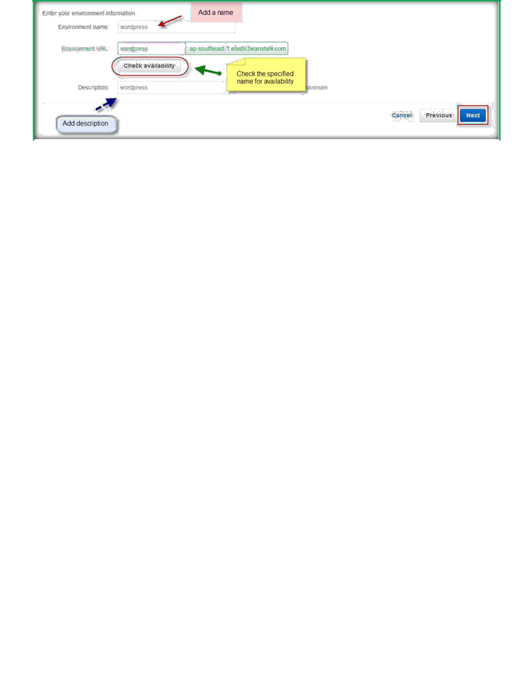
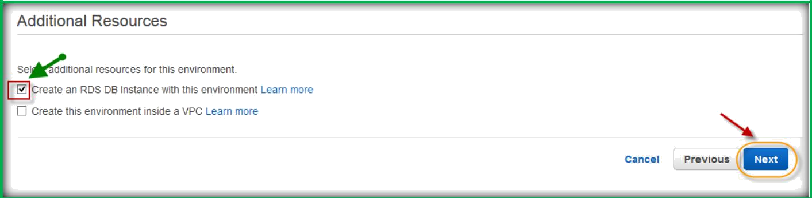
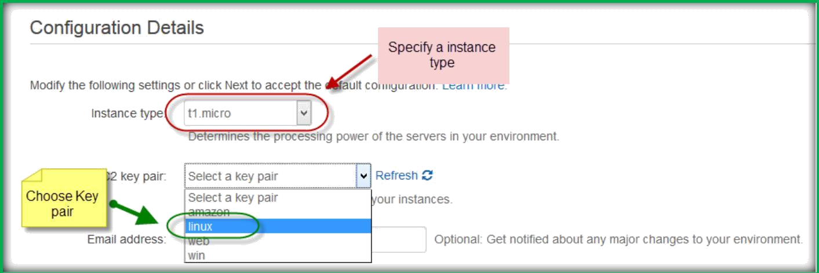
Choose additional Resources which needs to be created with this configuration.
I choose RDS here, then click on Next.
Specify the Instances specifications.
Specify an email id and choose monitoring type.

Slide 6
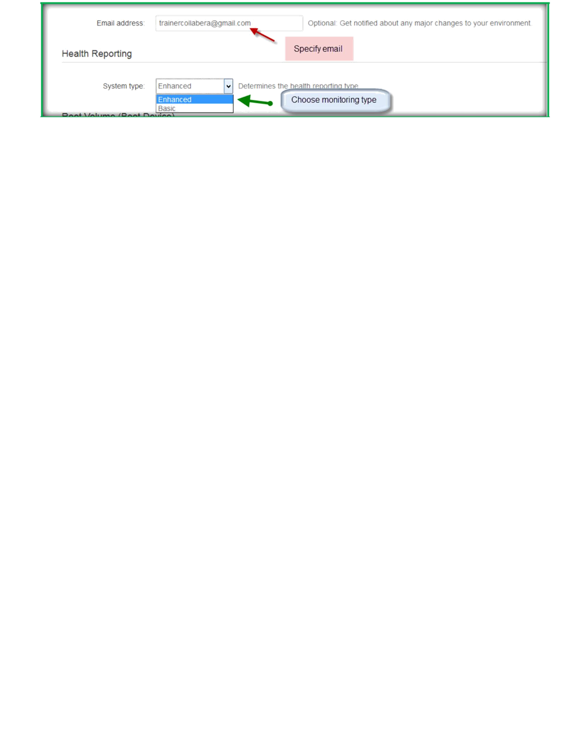
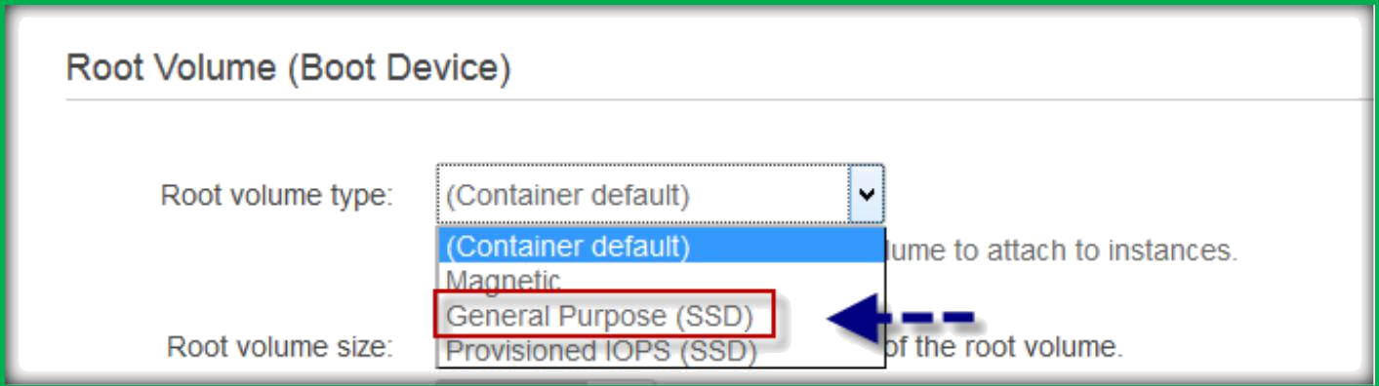
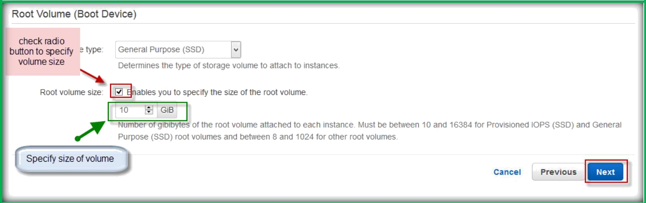
Select root volume type.
Specify root volume size, then choose Next.

Slide 7
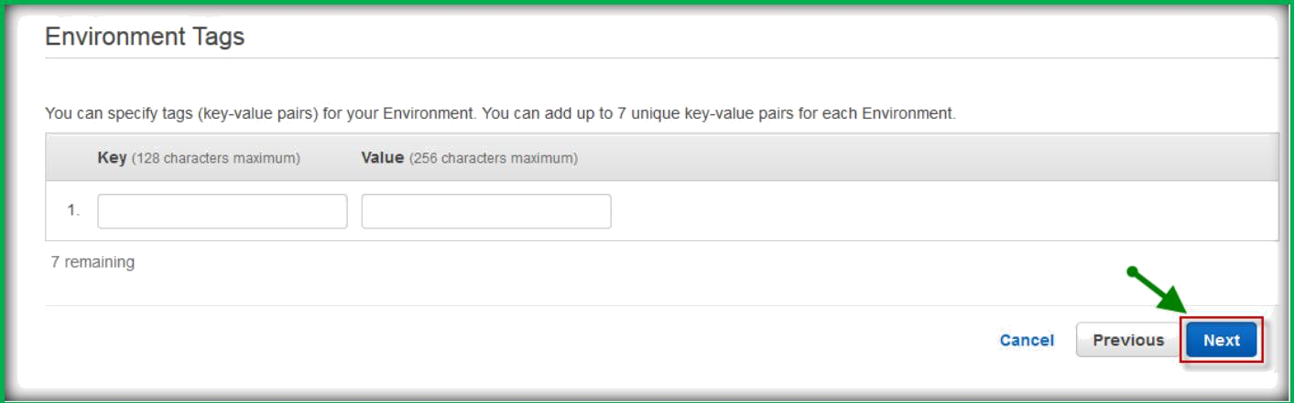
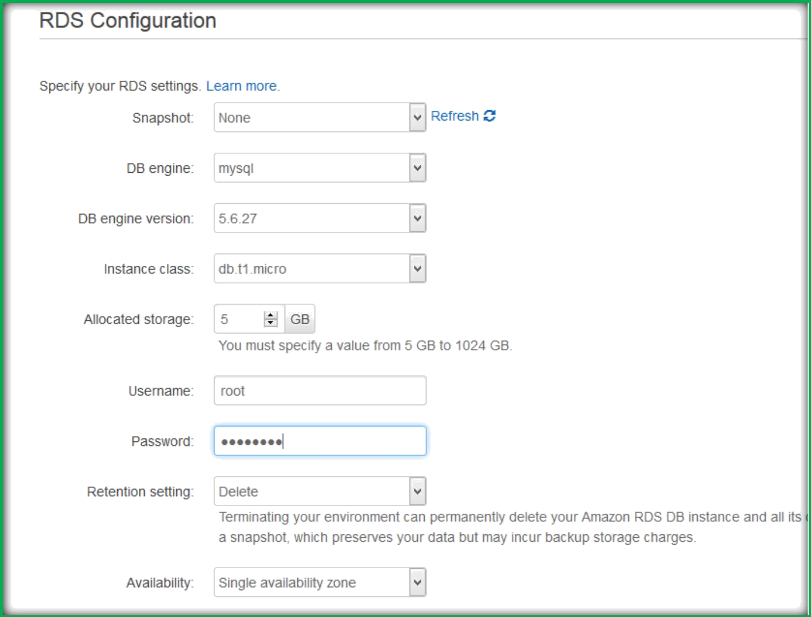
Add Tags if you want to add, then choose Next.
Then Specify all RDS configurations.

Slide 8
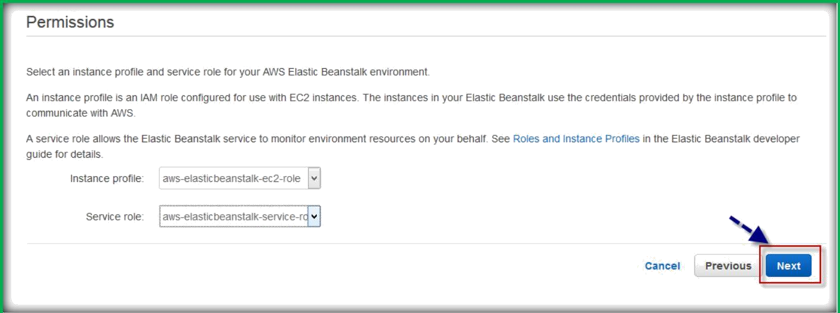
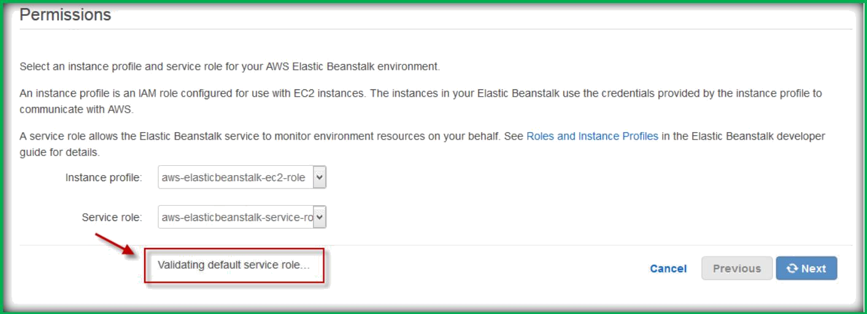
Choose Next to continue to next step.
It will validate your permissions.
Then finally choose Launch.

Slide 9
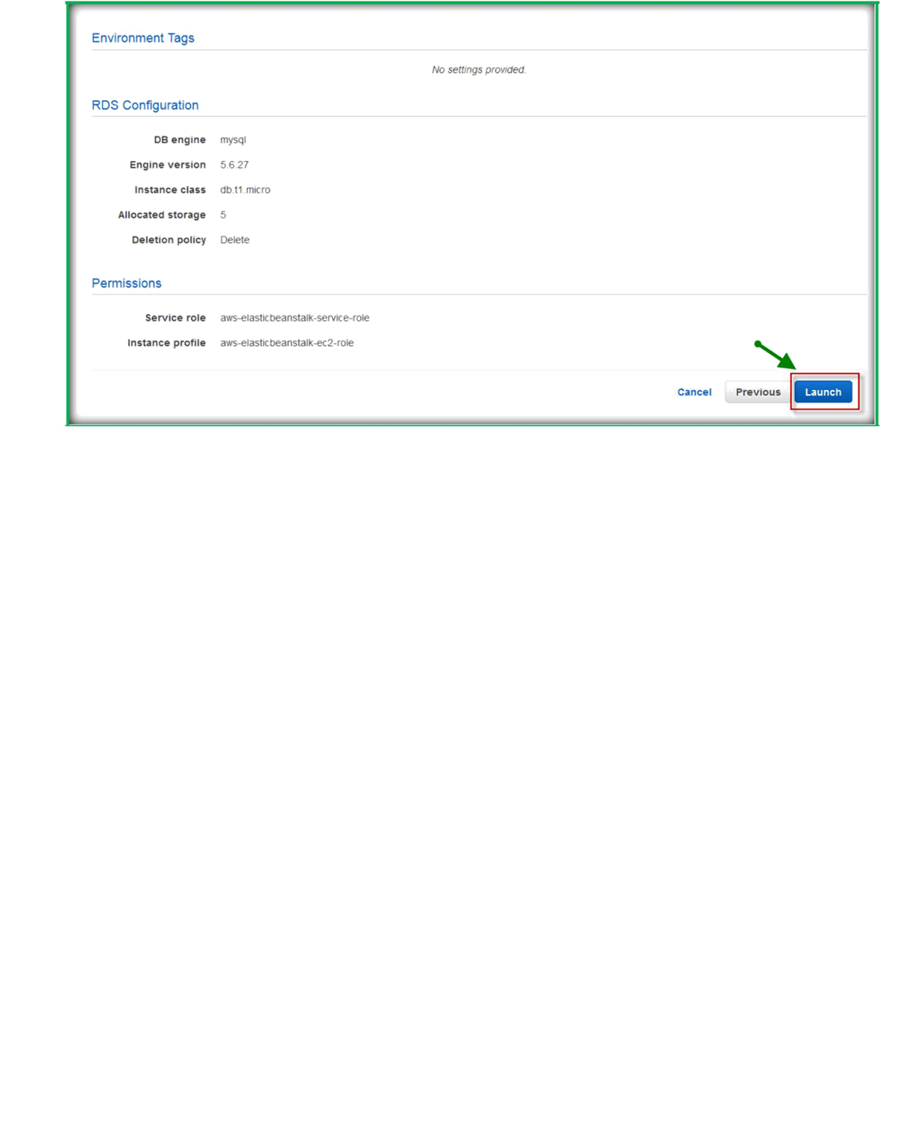
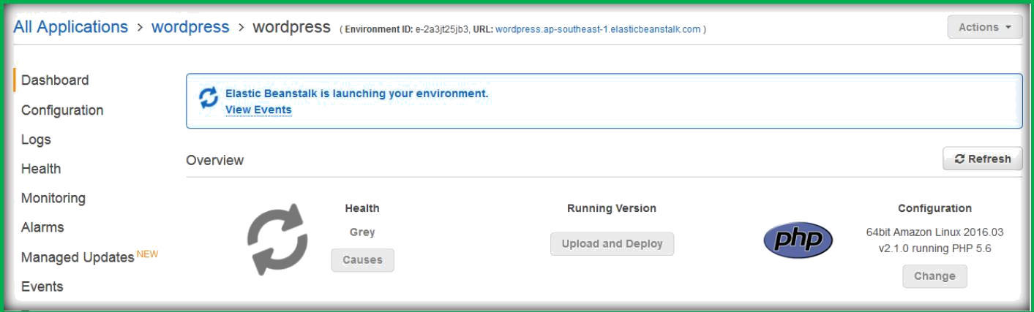
You can see that; application will start creating.
Once created, Health will come as green, then open the URL to access the application.

Slide 10
